Slide 1
A latent variable approach to infer genetic effects on atherosclerosis
Sanne Meijering

Slide 2
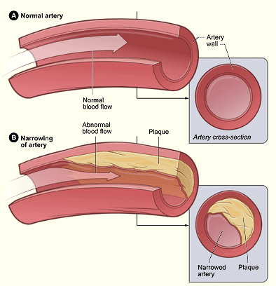
Background
Atherosclerosis: (partial) blockage of blood vessels by plaques
Genetics involved in forming of plaques and their composition
Goal: Finding the genes involved in plaque formation

Slide 3
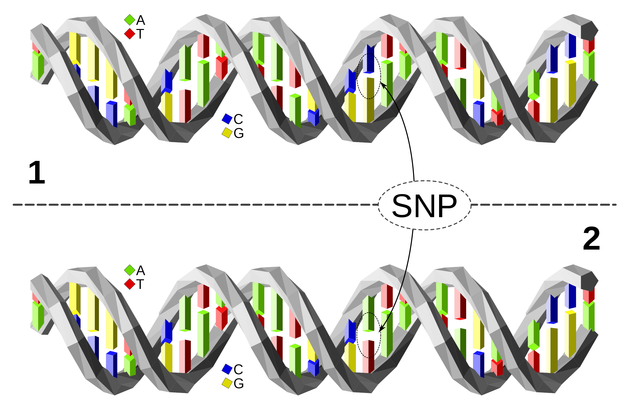
The Data
1358 samples of 80 million SNPs (reduced to 100k transcripts) and 7 outcome variables
SNPs: Single Nucleotide Polymorphism
Mutations
Appear in a significant portion of the population

Slide 4
The Method
The issues:
Huge dataset
Multiple outcomes: univariate methods yield no significant results
Thus, the method:
Must be computationally efficient
Must be multivariate (account for correlation between outcomes)

Slide 5
The method
PO2PLS: Probabilistic Two-way Orthogonal Partial Least Squares
Developed for comparison of two large (omics) datasets
Currently no reliable p-value calculation or estimation available

Slide 6
My goal (not yet definite)
Create a computationally efficient method to calculate reliable p-values
Implement the method in a package (R, C++)
If I have time left: find ways to improve method for outcome variables

Slide 7
Relevance
PO2PLS: Multivariate method for finding connections between genes and outcome variables
More likely to find significant genes due to higher power
Reliable p-values required for method to be used in research
New method in toolkit. To eventually better define atherosclerosis
Personal medicine

Slide 8
How?
Simulation studies
Bootstrapping
Further data reduction?

Slide 9
Any Questions?

